Slide 1
RABIES
Presented By
Mrs.S. AKHILA DAS M.Sc (N)
Asst. Professor
Department of Community Health Nursing
Annammal College of Nursing

Slide 2
Introduction:
Rabies is a zoonotic disease caused by lyssavirus type 1 of family rhabdoviridae. It is known as hydrophobia. The victims of dog bite are under the age of 15 years. Most human deaths follow a bite from an infected dog.

Slide 3
Definition
Rabies is deadly virus disease affecting the central nervous system which is caused by Lyssavirus type 1 of family rhabdoviridae

Slide 4
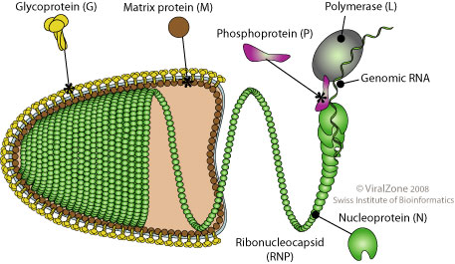
EPIDEMIOLOGICAL TRIAD
AGENT : Lyssavirus Type 1of family Rhabdoviridae

Slide 5
Virus excreted through saliva of affected animal
Source of infection- saliva of rabid animal
Rabies occur in three epidemiological forms such as urban, wild life and bat rabies
One dog is capable of biting large number of humans and animals

Slide 6
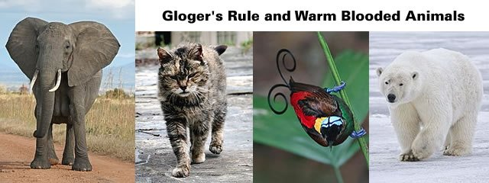
HOST FACTOR
a. At high risk including man

Slide 7
b.Dog handlers

Slide 8
c. Hunters

Slide 9
d. Veterinarians

Slide 10
e. Laboratory staff working with rabies virus

Slide 11
ENVIRONMENTAL FACTORS
Rabid dogs and cats which have rabies virus in saliva
Vampire bat
Jackal, fox are wildlife carriers which are the main reservoir and transmitter of rabies

Slide 12
MODE OF TRANSMISSION
Bite of an infected animal
Open scratch or wound in contact with infectious material such as blood or saliva
Human to human in case of corneal transplant
By mucous membrane when it comes in contact with infectious material

Slide 13
CLINICAL MANIFESTATION
Fever
Headache
Muscle ache
Loss of appetite
Nausea
fatigue

Slide 14
As infection progresses
Irritability
Confusion
Agitation
Abnormal thoughts
Posture changes
Convulsion
Paralysis
Extreme sensitivity to bright light, sound, touch
Increased production of saliva or tears
Difficulty in speaking

Slide 15
In advanced stage- spread to nervous system
Double vision
Problems in moving facial muscles
Abnormal movements of diaphragm
Difficulty in swallowing
Increased production of saliva causing foaming of mouth

Slide 16
DIAGNOSIS
History of bite by a rabid animal
Clinical signs and symptoms especially hydrophobia
Antigen detection using immuno fluorescence of skin biopsy
Isolation of virus from saliva

Slide 17
PREVENTION AND CONTROL MEASURES
Early diagnosis and treatment
in case a dog has bitten a man,
Promptly scrub the site with soap & water
Apply alcohol on wound
Administer Rabies immunoglobulin around the site of bite
Administer fine dose of tissue culture vaccine including human diploid cell rabies vaccine on the 0, 3,7,14 and 28 after exposure

Slide 18
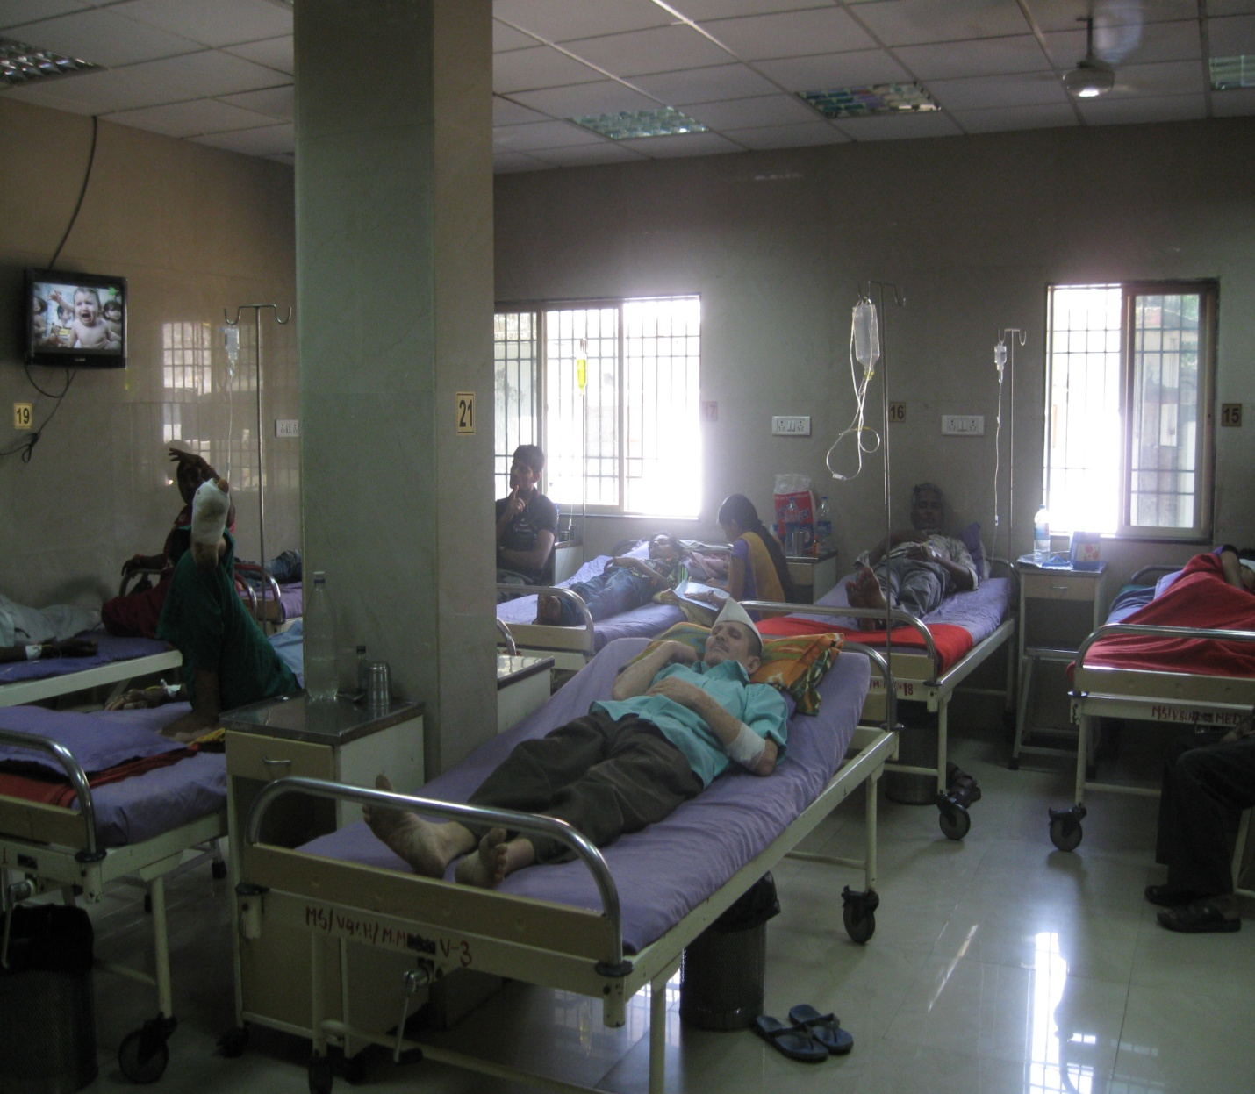
Other measures
2. Impartiality and Scientific Attitude:
Politicians must resist the temptations to use information services for party and tendency to acquiesce to the demands of their political masters and be constantly vigilant of the limitations that should be imposed on their role

Slide 19
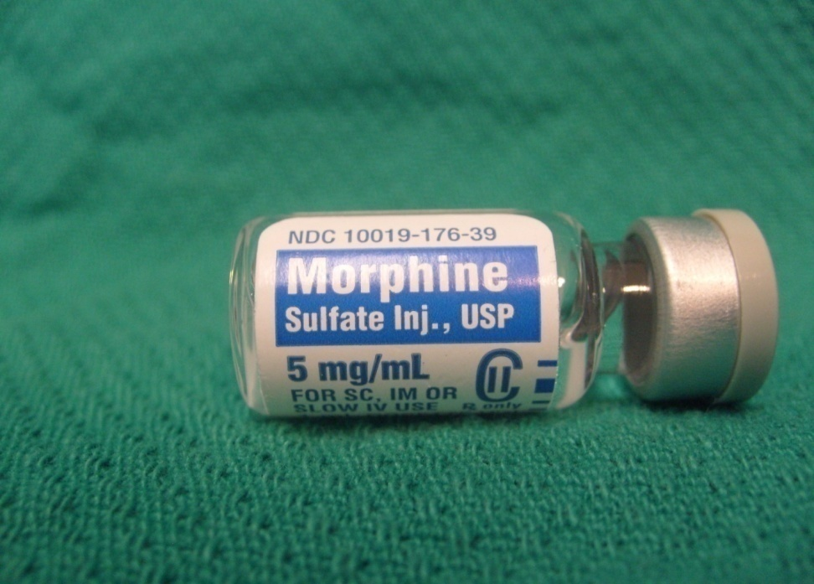
b. Reduce anxiety and pain
By administering sedatives such as morphine sulphate

Slide 20
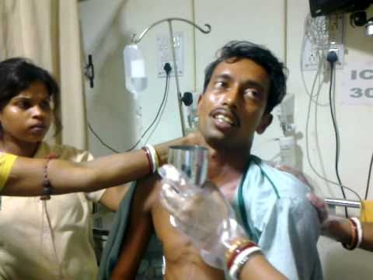
c. Hydration
IV fluids bottles should be covered
Monitor urine output to assess kidney function

Slide 21
d. Intensive Care

Slide 22
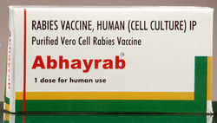
e. Vaccine
Human diploid cell vaccine
Purified chick embryo cell vaccine
Rabies immunoglobulin

Slide 23
CONTROL THE DOGS CAUSING RABIES AND PROPER HANDLING
Remove all stray dogs and cats
Have all pets vaccinated
Do not allow bats to live in house chimney
Avoid picking up dead animals
Do not eat animals that do not look normal
Use gloves while skinning animals while handling nervous tissues

Slide 24
NURSING MANAGEMENT
Isolate the patient
Provide optimum comfort
Darken the room and provide quiet environment
Should avoid bathing, running water in room or near the room at hearing distance
IV fluids should be wrapped and needles should be securely anchored to avoid dislodging

Slide 25
THANK YOU

